Slide 1
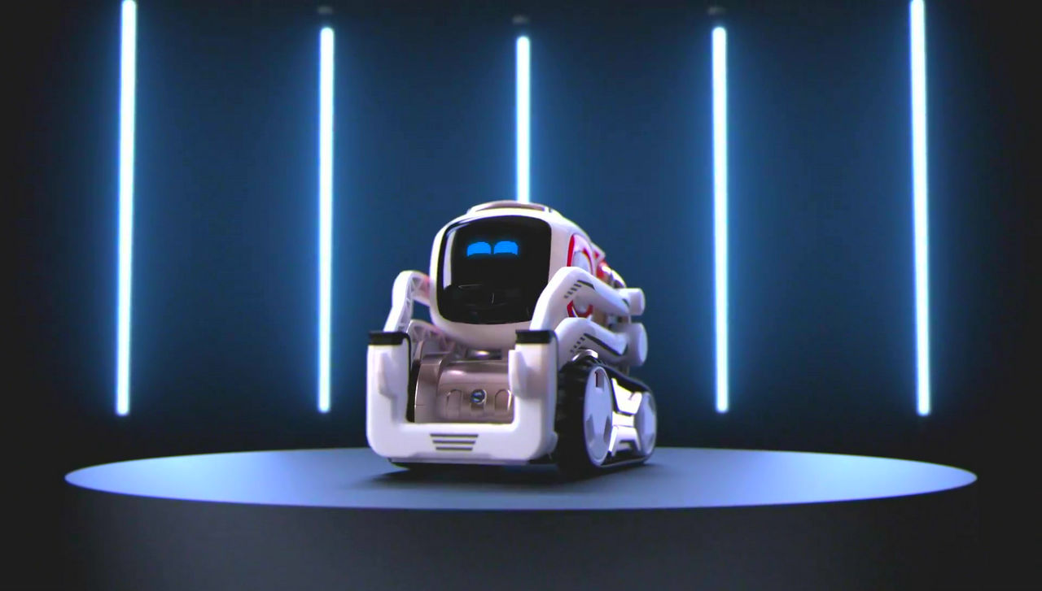
Cozmo Project
Group 5: Chor Shuan, Jeremy, Li En, Mei Tian

Slide 2
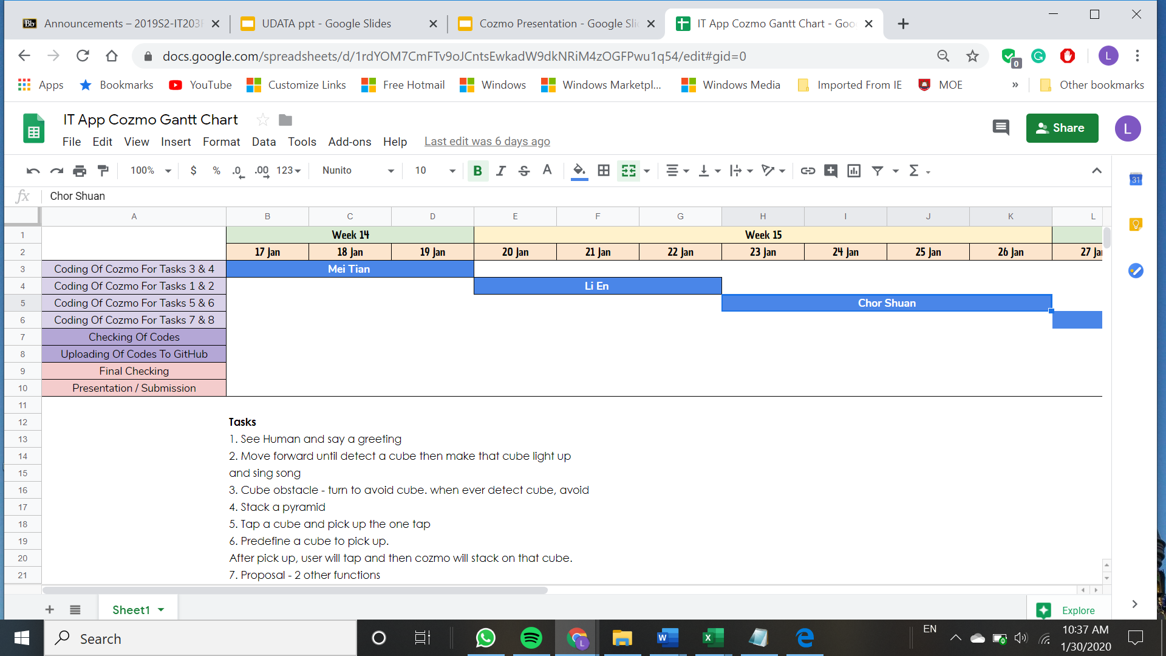
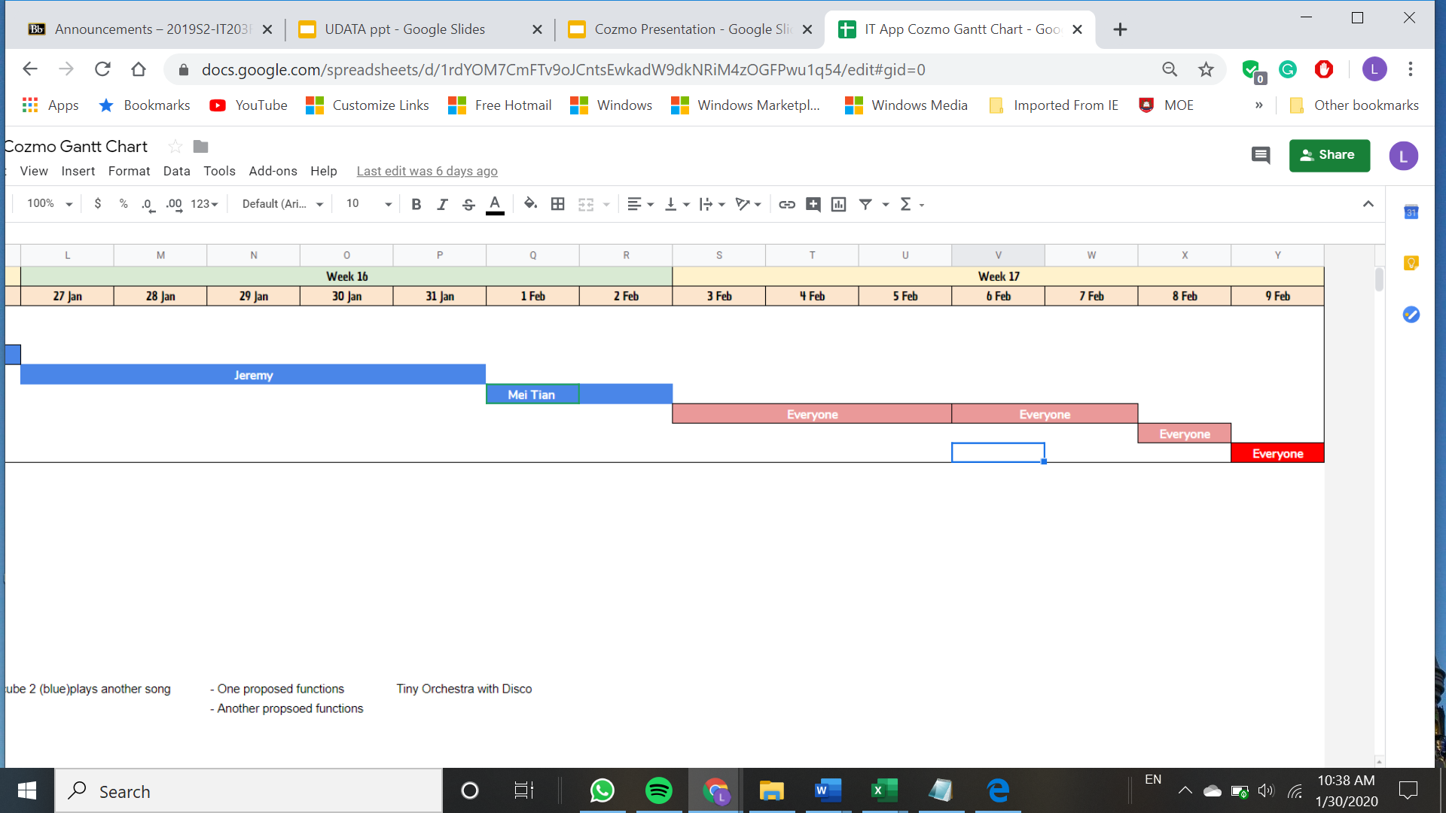
Timeline

Slide 3
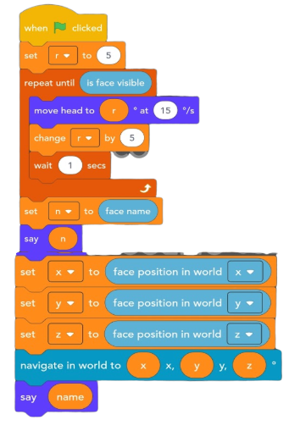

Li En
Code
Task 1- See a human and say a greeting.
Explanation:
Using variables to do the codes of detecting the face
So if unable to detect it would keep repeating by moving its head at 15 degrees/s

Slide 4
Li En
Explanation
So it is supposedly detect a cube 1 when it is visible.
When it docks with the cube , it should throw it to display that it has succeeded
Sing song to end the whole system /cycle
Task 2: Move forward until detect a cube then make that cube light up and sing song.

Slide 5

Task 3: Cube obstacle - turn to avoid cube. when ever detect cube, avoid.
Mei Tian
Explanation
When flag is clicked, Cozmo will start moving.
If any cube is seen, Cozmo will turn to avoid.
If no cube is seen, Cozmo will continue moving.
Notes:
Features. - like it dance or smth
Eh if the code too llong still add in ah ?
Yeahh jem say what use key points , then is pointless
U saw hoe lerwin team did yaa
Maybe don’t add code but what it will do
Yea like Lerwin’s team
Where you
Come find me in porject room 5
Idk where that is
Alr say whatgo level 5 centre wing
Walk middle u will see a room
Alamak the elevator here not working

Slide 6

Task 4: Stack a Pyramid
Mei Tian
Explanation
When Cube 1 is visible, Cozmo will dock and lift it.
After that, it will continue to turn 15 degrees until Cube 2 is seen.
When Cube 2 is visible, Cozmo will place Cube 1 next to Cube 2.
Next, Cozmo will turn 15 degrees until Cube 3 is seen.
When Cube 3 is seen, Cozmo will dock with Cube 3 and place it in the middle of Cube 1 and Cube 2.
A pyramid is stacked!
Notes:
Features. - like it dance or smth
Eh if the code too llong still add in ah ?
Yeahh jem say what use key points , then is pointless
U saw hoe lerwin team did yaa
Maybe don’t add code but what it will do
Yea like Lerwin’s team
Where you
Come find me in porject room 5
Idk where that is
Alr say whatgo level 5 centre wing
Walk middle u will see a room
Alamak the elevator here not working

Slide 7
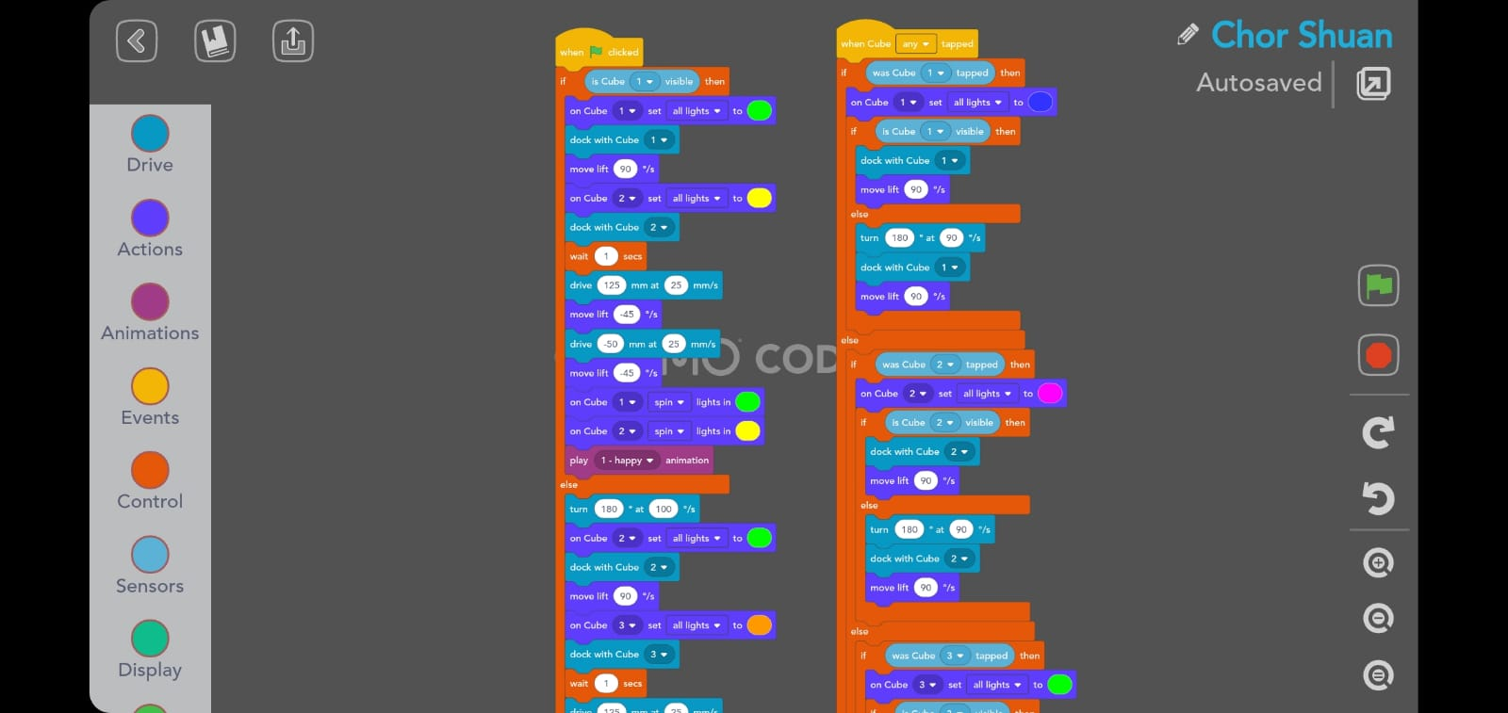
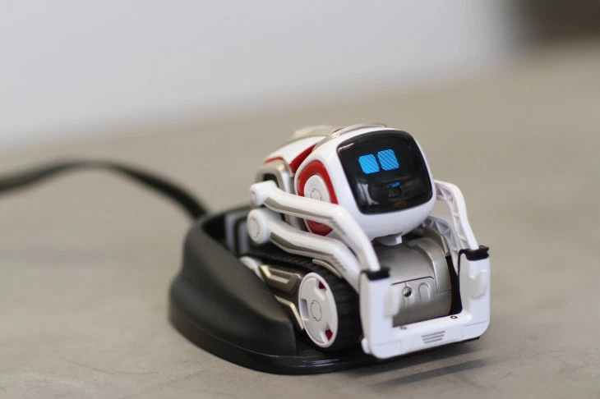
Task 5: Predefine a cube to pick up, after picking up, cozmo will stack on another cube.
Chor Shuan
Code
Notes:
Features. - like it dance or smth
Eh if the code too llong still add in ah ?
Yeahh jem say what use key points , then is pointless
U saw hoe lerwin team did yaa
Maybe don’t add code but what it will do
Yea like Lerwin’s team
Where you
Come find me in porject room 5
Idk where that is
Alr say whatgo level 5 centre wing
Walk middle u will see a room
Alamak the elevator here not working

Slide 8
Task 6: Tap a cube and pick up the one tapped.
Chor Shuan
Code
Notes:
Features. - like it dance or smth
Eh if the code too llong still add in ah ?
Yeahh jem say what use key points , then is pointless
U saw hoe lerwin team did yaa
Maybe don’t add code but what it will do
Yea like Lerwin’s team
Where you
Come find me in porject room 5
Idk where that is
Alr say whatgo level 5 centre wing
Walk middle u will see a room
Alamak the elevator here not working

Slide 9
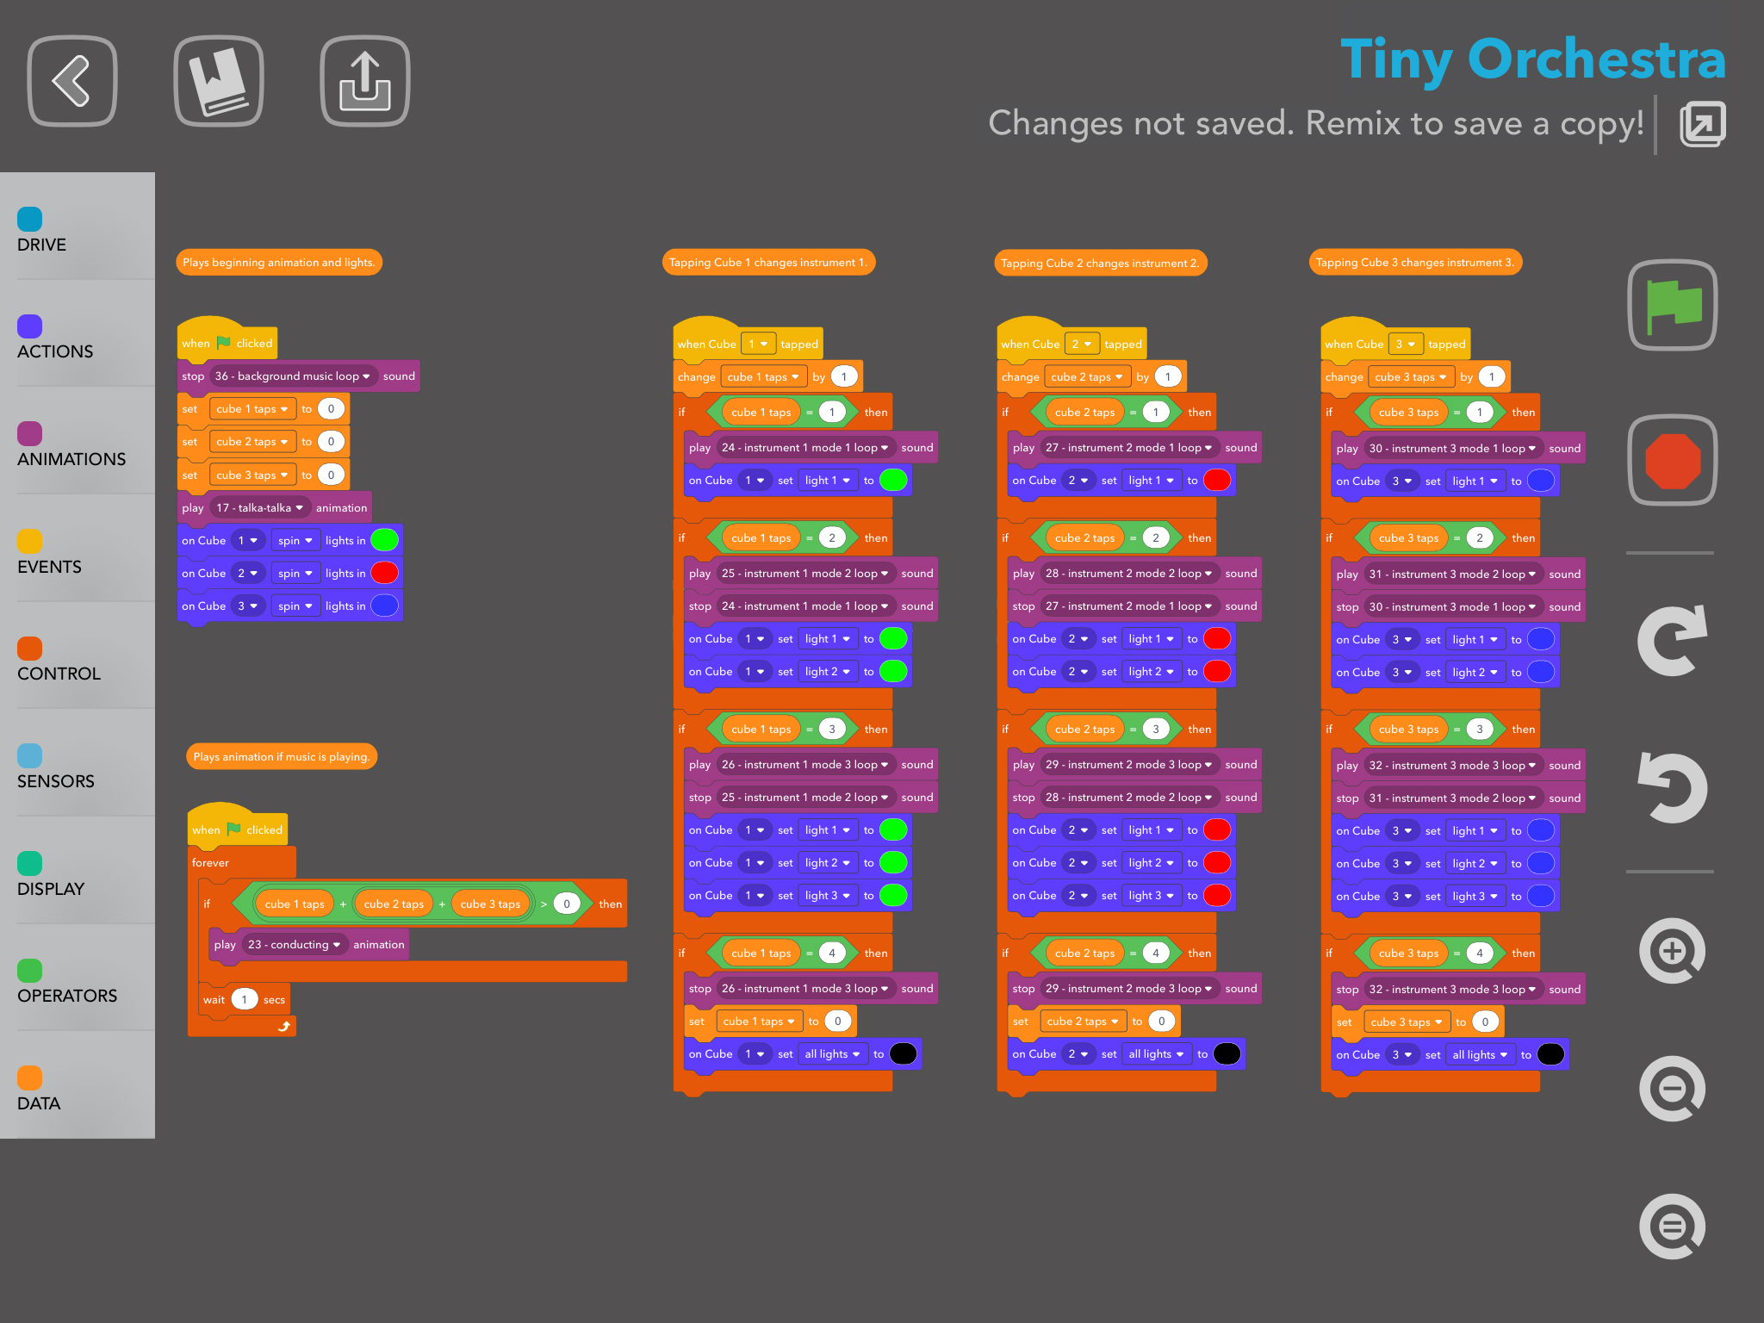

Jeremy
Task 7
Small Orchestra Disco-
Explanation
Upon tapping each cube music and colour will change.

Slide 10
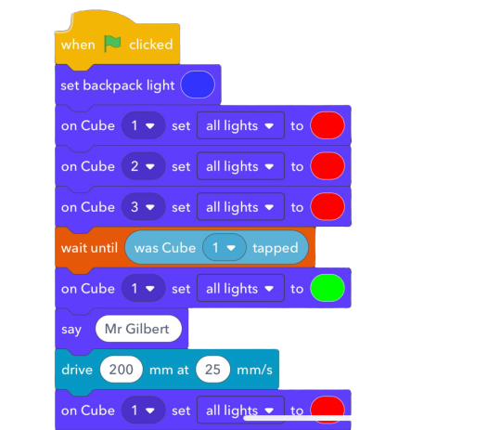

Jeremy
Code
Task 8- Traffic Light Show:
Upon tapping on cube 1, it will move to cube 2 and to cube 3.
It will turn back back to the initial cube upon tapping on it,

Slide 11
Challenges Faced
Difficult to code when the code that we’ve created did not work
Anki forum closed
Not enough functions on the constructor mode
Cannot multitask
It doesn't allow to people to construct the code
Code can only be saved in one phone
Notes:
For the final presentation you will need a couple of slides to summarize what r your features your team implemented and perhaps have a slide stating some of the challenges faced and how u guys solved it. Include a slide to show the planning (ie time line of how u guys split the tasks)

Slide 12
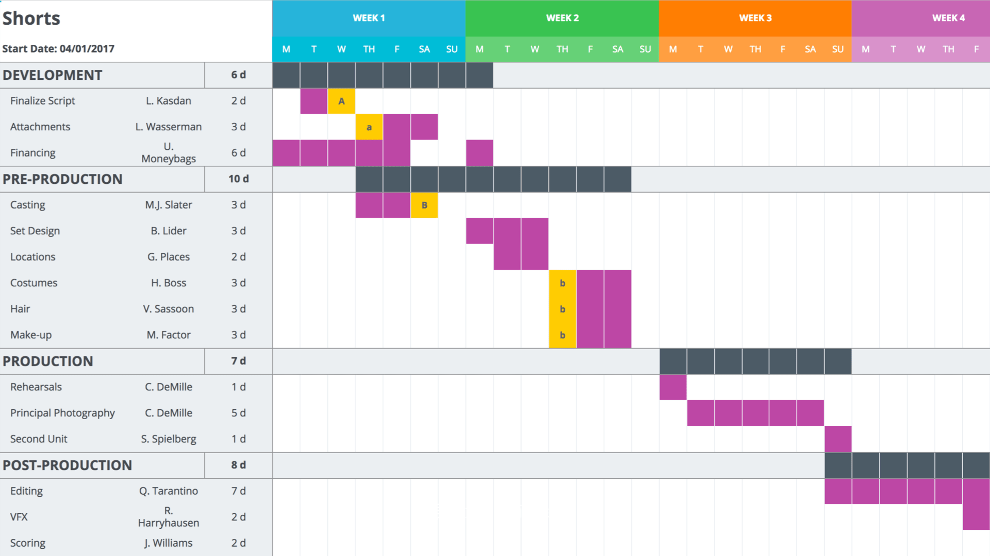

How it is solved ?
Effectively plan our schedule
(eg. indicate how long is required for each task)
With a delegated time schedule, everyone is expected to meet the deadline and finish the project on time
Gantt Chart
Whatsapp
Notes:
For the final presentation you will need a couple of slides to summarize what r your features your team implemented and perhaps have a slide stating some of the challenges faced and how u guys solved it. Include a slide to show the planning (ie time line of how u guys split the tasks)

